Slide 1
Welcome to DeltaV!
Aaron Horn
Chief Operating Officer
The New Bohemian Innovation Collaborative
@NewBoCo | @DeltaVCode

Slide 2
Aaron Horn
Went to school in Adel, Iowa
Went to college at Iowa State University
Studied Management Information Systems & Entrepreneurship
I’ve always worked in IT, but in different industries
Agriculture Manufacturing for 12 years
Healthcare Software for 1 year
Railroad for 2.5 years
Involved in running 4 nonprofits

Slide 3
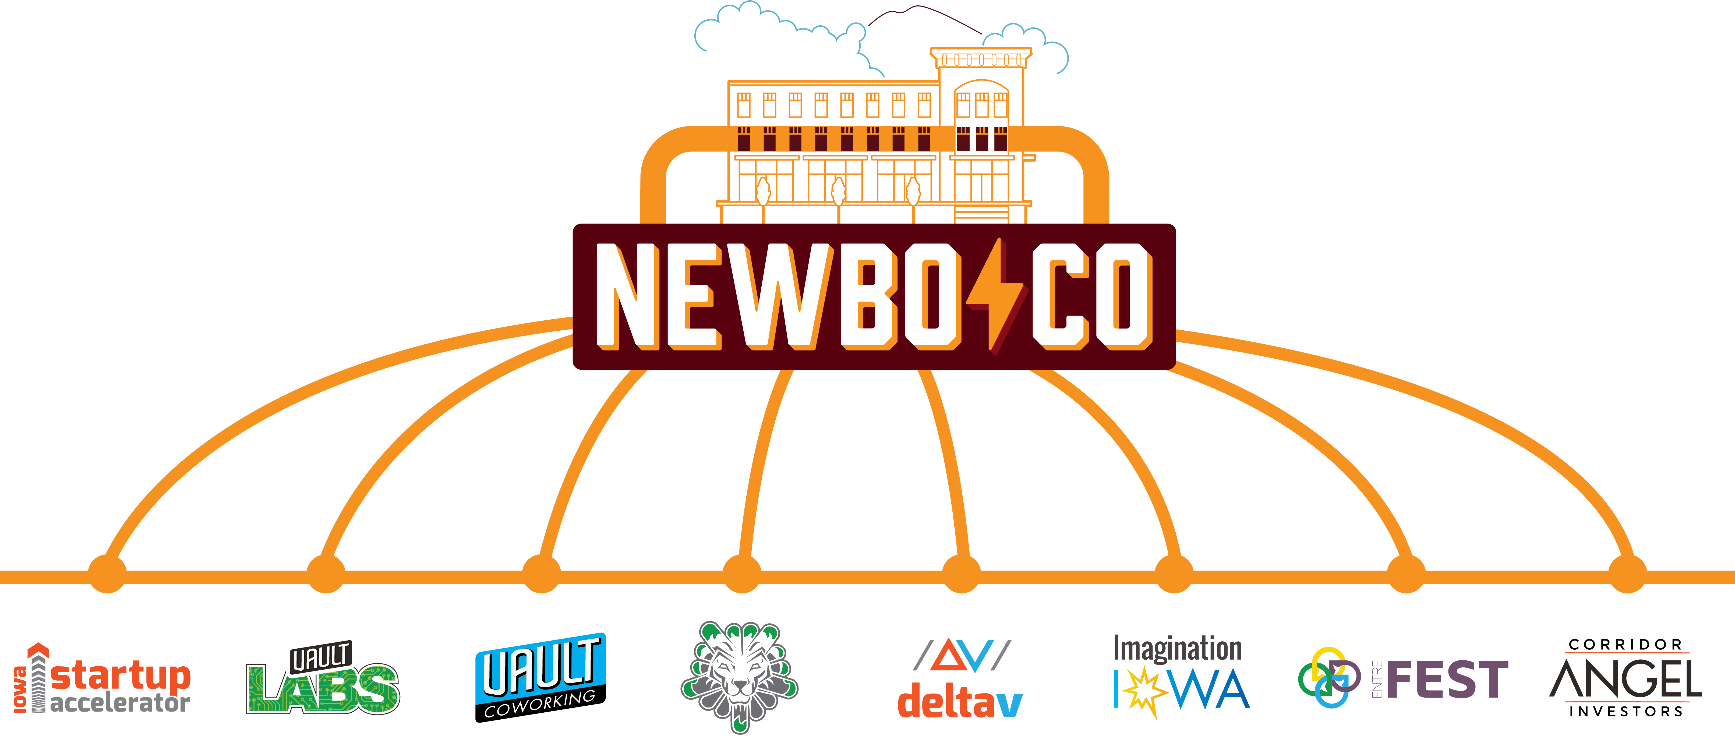
Notes:
Nonprofit

Slide 4
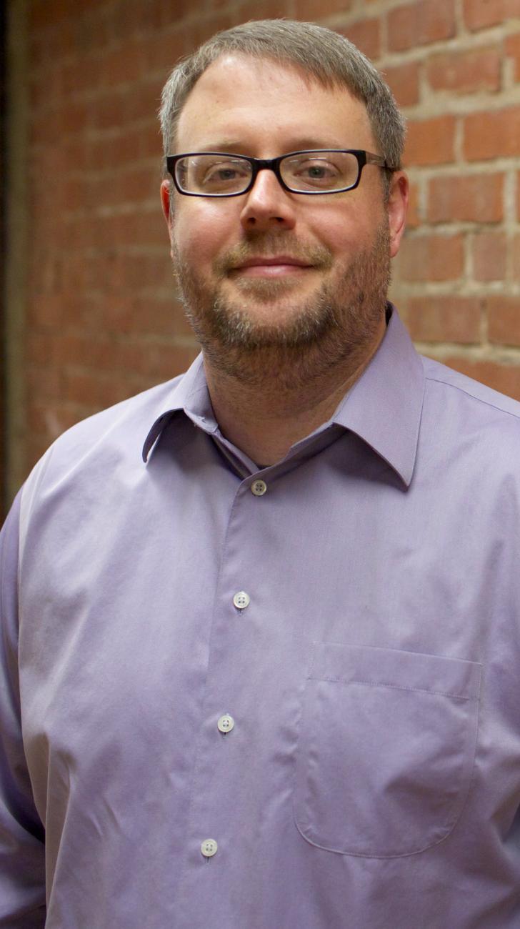

Slide 5
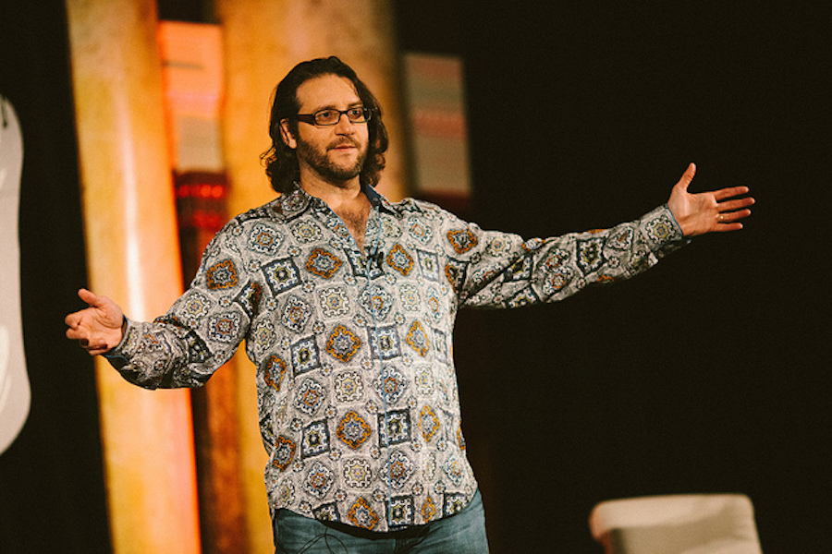

Slide 6
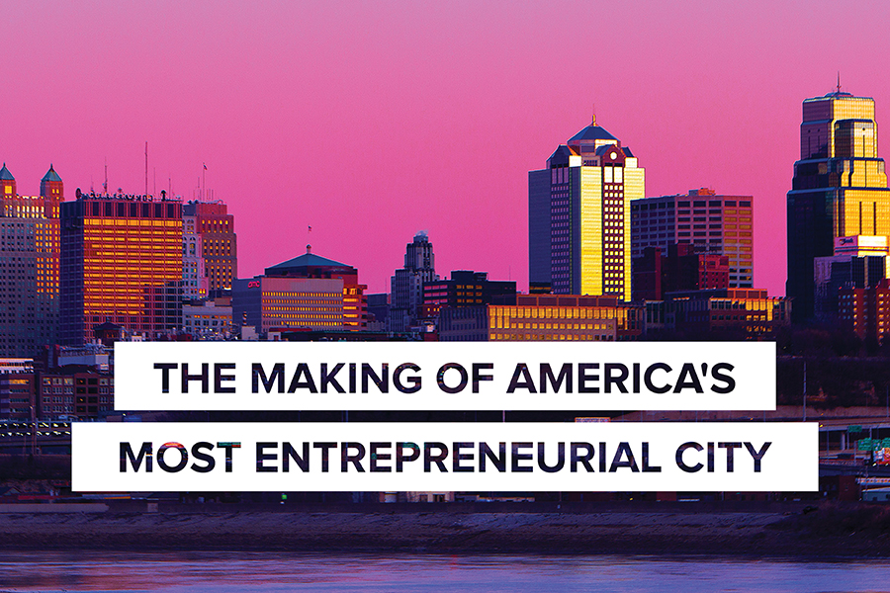
We visited the greatest startup communities in the world
Notes:
Silicon Valley
Boulder & Denver
London
New York City
Atlanta
Kansas City
Nashville
Chicago

Slide 7
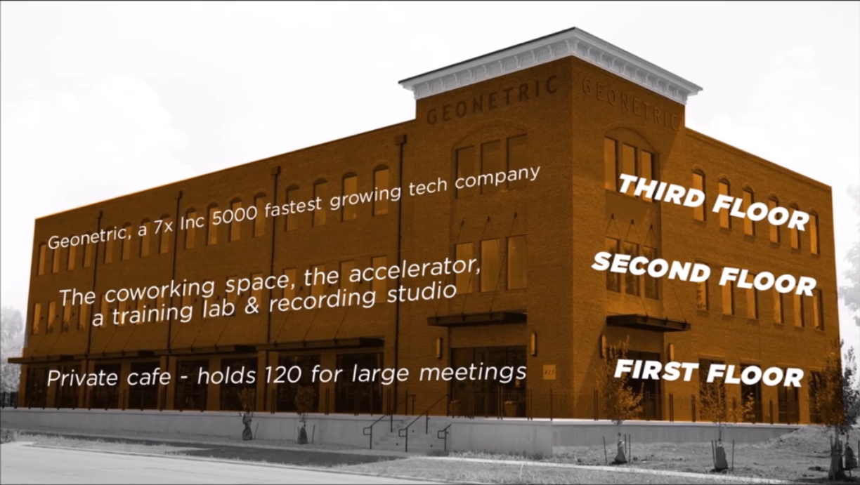
We opened a facility to create tech & startup density where none existed
Notes:
415: creating the tech & startup density that didn’t exist
250 nerdy people

Slide 8
What | Why
Innovation: Fostering strong organizational cultures & leadership, an agile mindset, and the right strategies | To create more rapidly-growing, resilient companies in Eastern Iowa
Education: Niche technology education for kids, teachers, and adult career-switchers | To build a stronger talent pipeline for fast-growing companies in Eastern Iowa
Entrepreneurship: Providing investment, mentoring, office space, and community resources to entrepreneurs | To increase the number and quality of startups in Eastern Iowa.

Slide 9
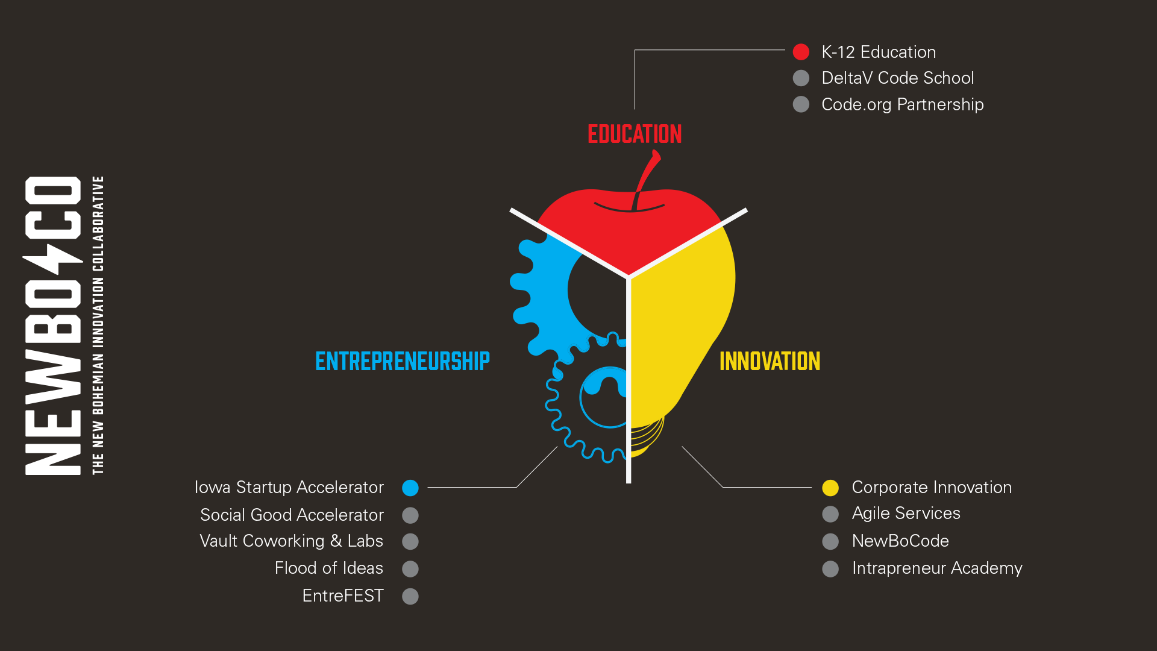

Slide 10
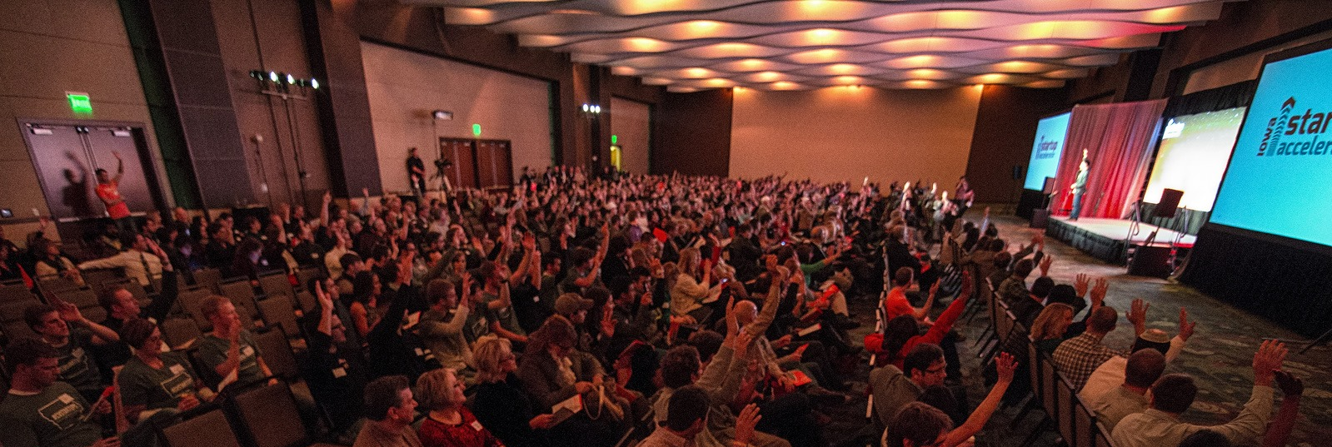
We launched the state’s first accelerator program
Notes:
We didn’t have an accelerator program that focused on early stage, tech companies. So we built one.
, TOFU
34 companies so far, X are still alive.
19/X are in iowa
If there are no deals in Iowa to invest in, we will bring them here, and hopefully get them to stay. X companies have stayed.

Slide 12

We built the region’s first formal angel network
Notes:
Needed a regional angel network to raise money for startups: So we built one.
Coordinated a raise of $1.3 million with sponsor (and legal experts) @ S&I
About 40 investors right now, aiming for 100

Slide 13
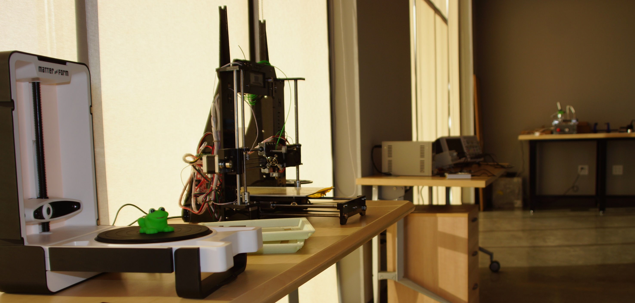
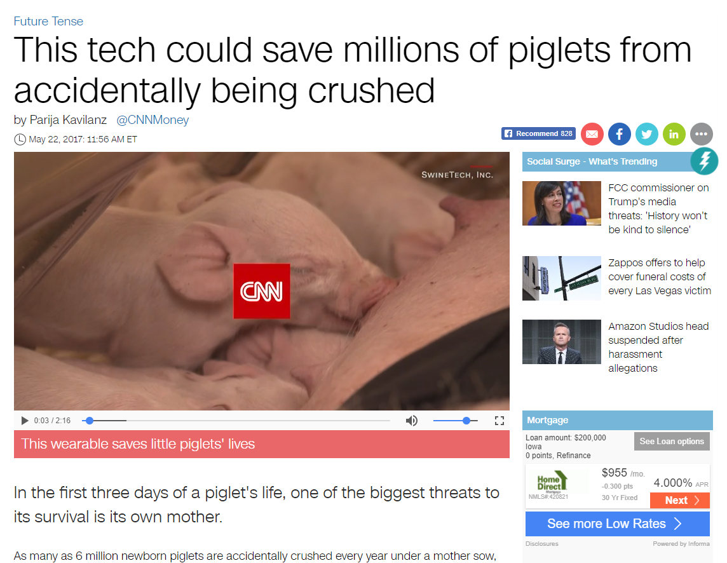
We opened the region’s first public prototyping lab
Notes:
The region’s first publicly available prototyping labs and VR labs – and it helped us recruit a startup from Michigan, GovRED technologies, that’s developing police and military simulating using VR

Slide 14
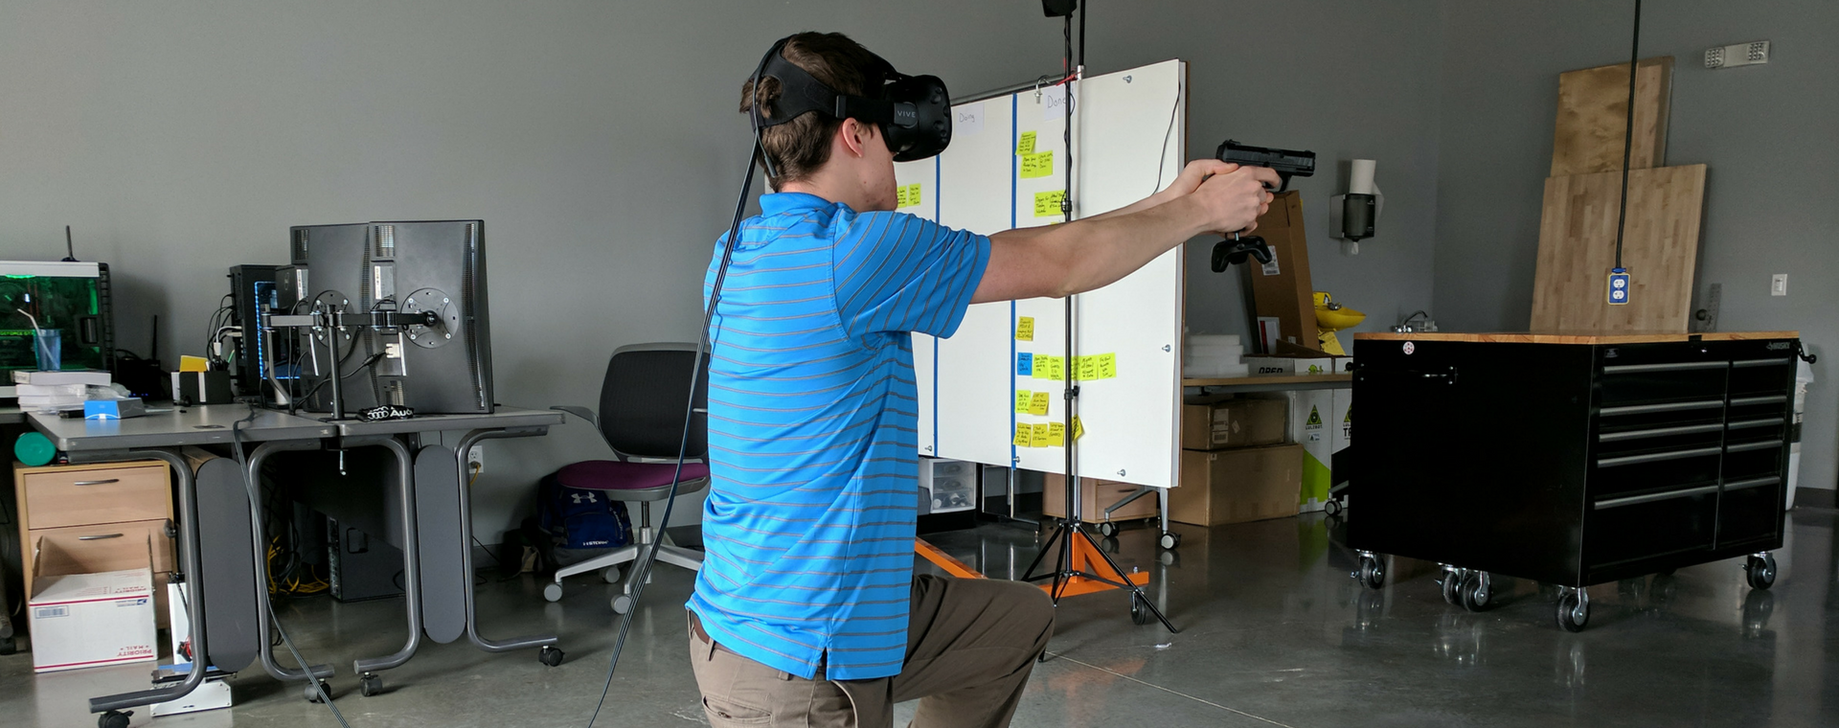
And the first public Virtual Reality lab

Slide 15
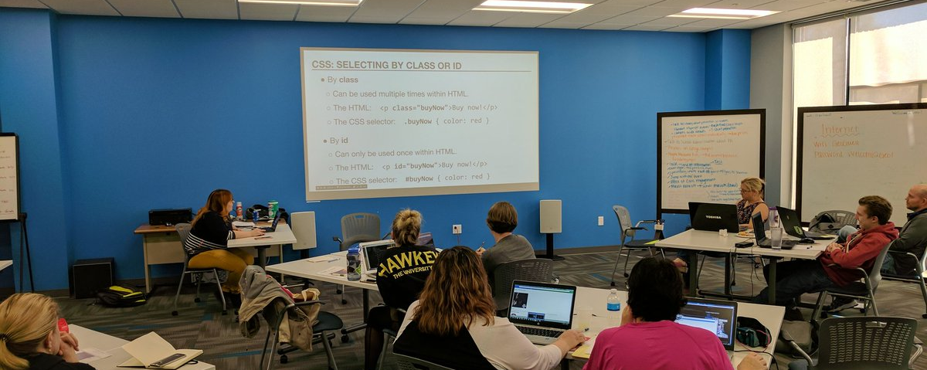
We launched Iowa’s first adult code school
Notes:
Entrepreneurs need tech cofounders.
Adult computer science education: We built Iowa’s first code school

Slide 16
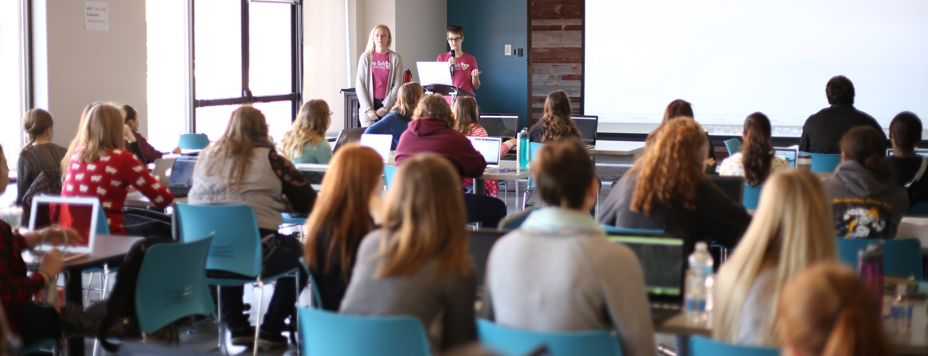
We created more than 15 tech, code, leadership and entrepreneurship programs for kids
Notes:
Easily 1500 kids per year have explored comp sci and stem
Iowa Girls Code Camp: 50 high school girls learning to code. Iowa produces very few compsci college graduates. We’re hoping to make compsci a viable path for highschool girls

Slide 17
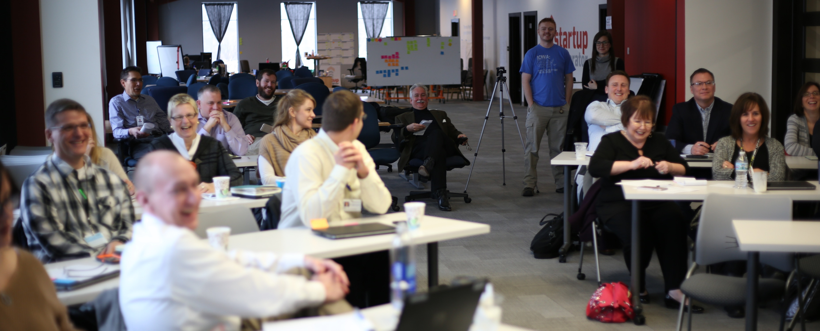
We launched innovation training programs
Notes:
48 companies have used our services to help build more innovative cultures, and have more visibility of disruption

Slide 18
48 companies have participated in our innovation & agile training programs 2 of those are Cedar Rapids-based 2017 Inc. 5000 fastest growing companies

Slide 20
What we are not
Notes:
Silicon Valley
Boulder & Denver
London
New York City
Atlanta
Kansas City
Nashville
Chicago

Slide 21
What we are not
Notes:
Silicon Valley
Boulder & Denver
London
New York City
Atlanta
Kansas City
Nashville
Chicago

Slide 22
What we are not
Notes:
Silicon Valley
Boulder & Denver
London
New York City
Atlanta
Kansas City
Nashville
Chicago

Slide 23
What we are not
Notes:
Silicon Valley
Boulder & Denver
London
New York City
Atlanta
Kansas City
Nashville
Chicago

Slide 24
100% of 2017-2018 reporting graduates found jobs in Iowa within 4 months
Average starting salary = $58,400

Slide 26
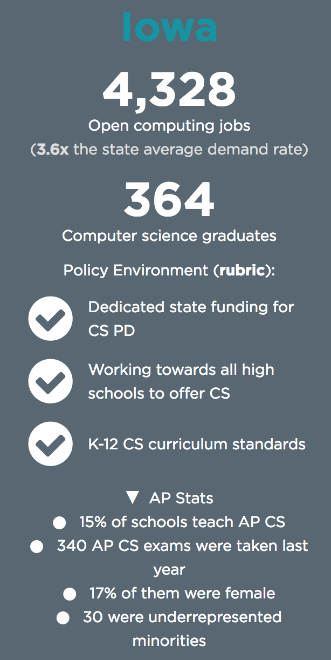

Slide 27
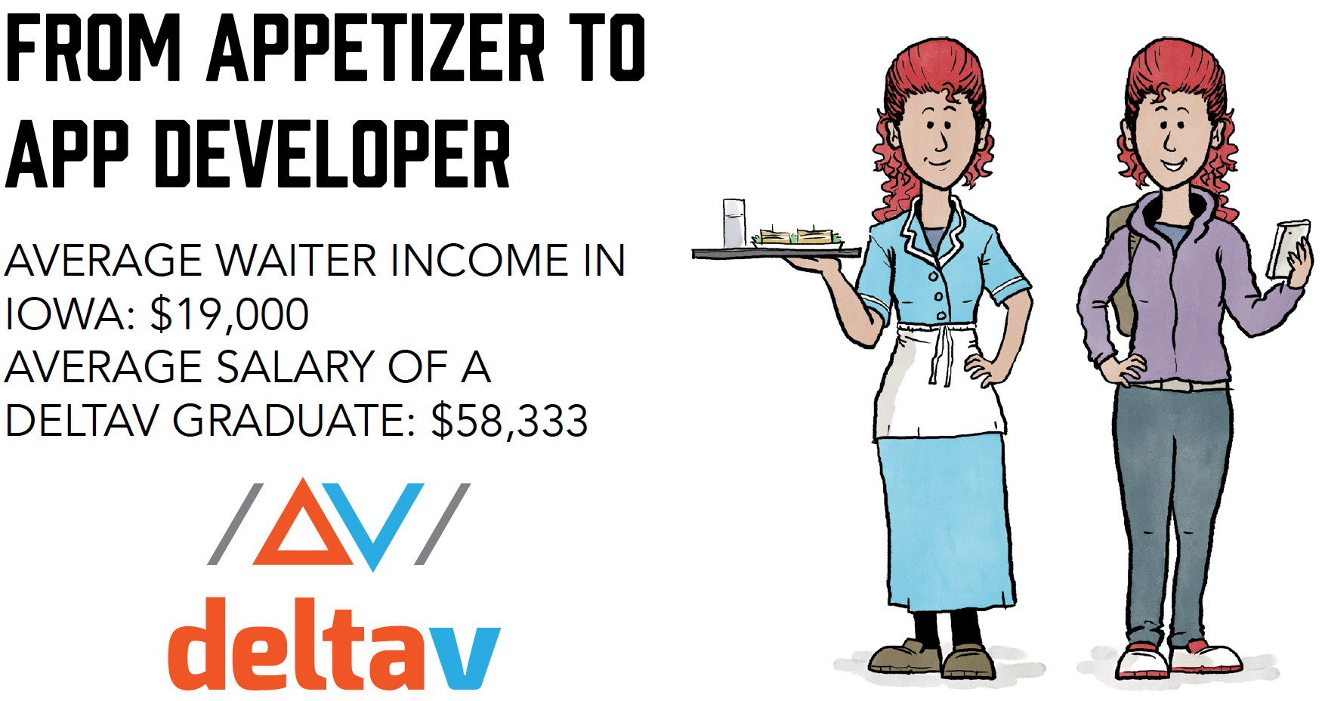

Slide 28
DeltaV works!
Jason
Military to Phone Sales to DeltaV to UFG Insurance
Ethan
Hy-Vee to DeltaV to Hy-Vee
Nathan
College to Band Teacher to DeltaV to Merchants Bonding Company

Slide 29
Thank You
aaron@newbo.co

